Slide 1
Student Rep: Basic Training 2023-24.
Please write name and ID number on register or in the ‘chat’

Slide 2
What we will cover
Introduction to London Met Students' Union
Student Rep Support
Role of a Student Rep
Making yourself known
Feedback & Representation
Break (ten minutes)
Decision-making
Course Committee Meetings
LMSU policies to be aware of
Training feedback form

Slide 3
Icebreaker
Name?
Course?
Why did you become a Student Rep?

Slide 4
Who are the London Met Students’ Union (LMSU)?
The Students’ Union is an independent charitable organisation lead by students via a number of full-time and part-time student officers, supported by a team of full-time staff. We represent your academic and non-academic interests at university
We are based at the Holloway and Aldgate campuses and also operate remotely.
Student Rep scheme is a partnership between the Student’s Union and the University.
There should be Student Rep for each year (or ‘cohort’) of each course at the University
Student Reps are able to achieve an accreditation and recognition on degree transcripts.
Student Reps can develop excellent transferable skills such as problem solving, negotiation, communication, lobbying and campaigning
Being a Student Rep can be rewarding, enjoyable and help you to get to know other student and a great way to get more involved the Students Union
Notes:
Led by students for students
Student rep role has many benefits such as … that are useful for your personal and professional development and its also a …

Slide 5
Advice, Support, Resources and Tools
The Student Rep Handbook 2023-24 contain everything you need to know to be a great Student Rep. All the information in this training is within it. It is on our website too.

Slide 6
Advice, Support, Resources and Tools
Your School Rep Assistant - Student staff member who is your main contact within the Students’ Union. They work five hours a week supporting student reps
Your Vice-President Education Tammika Chambers. Full-time Students’ Union Officer with academic affairs / education remit.
Student Rep page on LMSU website - Full information on Student Reps at London Met. Links to remote Student Rep events such as training and all-school meetings available for all student who have a student username and password.
LMSU Volunteers Weblearn Organisation - training organisation for all volunteers in LMSU (including Student Reps)
London Met Student Zone - loads of useful information about London Met uni which student may ask you about.

Slide 7
Students’ Union Contact information
The School Rep Assistant for your school is your main contact point in LMSU. They are current London Met Students (and often current Students Reps) employed part-time by LMSU to support the Student Reps scheme. Tammika Chambers, Vice President Education is the elected officer who mainly works with and supports Student Reps from LMSU
Guildhall School of Business and Law (GSBL) and School of Human Sciences (SHSC):
Margarita Damai
schoolrepsGSBLHS@londonmet.ac.uk
School of Social Sciences and Professions (SSSP) and School of the Build Environment :
Sharanya Ratnam tssratn1@londonmet.ac.uk
Schools of Computing and Digital Media (SCDM) and Art, Architecture and Design (AAD): Chiara Della Corte schoolrepsSCDMAAD@londonmet.ac.uk
The full-time Officers in LMSU with the education and academic affairs remit in LMSU is:
Tammika Chambers
VP Education
su.education@londonmet.ac.uk

Slide 8
School / University contact information
School | Head of Student Experience and Academic Outcomes (HOSE) | Head of School | School Business Manager (School Office Head)
AAD | Emma Davenport E.Davenport@londonmet.ac.uk | Anne Markey a.markey@londonmet.ac.uk | Kamile Bundonyte k.bundonyte@londonmet.ac.uk
SHSC | Donovan Green d.green@londonmet.ac.uk | Elizabeth Opara e.opara@londonmet.ac.uk | Edward Gay e.gay@londonmet.ac.uk
SCDM | Elena Moschini e.moschini@londonmet.ac.uk | Christopher Lane c.lane@londonmet.ac.uk | Edward Gay e.gay@londonmet.ac.uk
GSBL | Jan Bamford j.bamford@londonmet.ac.uk | c/o Jan Bamford j.bamford@londonmet.ac.uk | Levent Bozdere l.bozdere@londonmet.ac.uk
SSSP | Brian Tutt b.tutt@londonmet.ac.uk | Kelly Marie Cooper kellymarie.cooper@londonmet.ac.uk | Maria Adu <m.adu@londonmet.ac.uk
SBEN | Jane Ballantyne j.ballantyne@londonmet.ac.uk | Sean Flynn s.flynn1@londonmet.ac.uk | Jane Ballantyne j.ballantyne@londonmet.ac.uk

Slide 9
What is the Role of Student Rep?
Shout out your answers or put them in the chat - what might a rep do?

Slide 10
What is the Role of Student Rep?
To represent student views and opinions on all matters relating to teaching and learning in an effort to continuously improve the student learning experience in partnership with the university and Students’ Union
Give feedback on behalf of your course mates to course leader and other teaching staff
Raise and issues or concerns your course mates may have in the same way
Report back to your course mates what the teacher's response is and keep reporting back – this is important
Build strong working-relationship with course leader & module leader etc
You can find the Student Rep role description of a rep here

Slide 11
How to make yourself known to your course mates
Shout out answers or put in the chat

Slide 12
How to make yourself known
Lecture and class shout-outs – speak to the course before a class or quickly during a break. Tell them you are the Student rep – 'word of mouth'
Collect the names and emails of the students on your course so you can communicate by email with them
Ask your course leader to put your name and details on the Course Site feature on Weblearn (see next slide).
Ask you course leader to put up a weblearn announcement to introduce you to the course or you can ask them to forward on an email from you to the whole course
Create a short online survey via google forms or survey monkey asking them how they are finding this new way of learning and ask your Course Leader to distribute it via weblearn
Use / create a WhatsApp group or similar for student on your course – this is entirely optional though. Don't feel under ANY obligation to share your number.

Slide 13
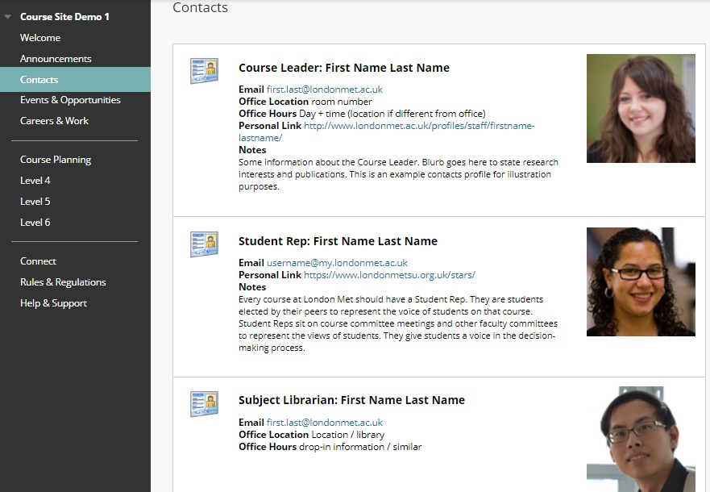
Weblearn - Course Site
This is a weblearn feature which really helps with the presence of student reps. You will need to email your course leader the following to activate it:
Confirmation you wish to be mentioned on the Course Site
Your email and photo (jpeg)
Link to Student Rep page on SU website
Link to a survey or google spreadsheet you may want to create to get feedback from course mates on their academic experience

Slide 14
Providing feedback
Providing feedback to the university is one of the key roles of student reps. What sort of issues might you might provide feedback to the university on?
Shout out your ideas

Slide 15
The ABCD of Effective Feedback

Slide 16
Five 'Rs' of Representation
In the process of gathering and presenting accurate, balanced, constructive and depersonalised feedback, it is likely you will find various issues you need to raise on behalf of your cohort with your Course Leader or other teaching staff. Here is a handy guide to help you in this process:
Reach out – students need to know who you are, how to contact you, know who you are, visibility, awareness stalls, drop-ins, social media presence, class visits, surveys and polls
Research – how widely and deeply felt is the issue?
Raise – Identify the person(s) to raise it with and raise it
Record – record what you did, who did you speak to, what did you say, when evidence did you use, minutes (notes) of meetings, what was the response, by whom and when?
Report – Close that feedback loop! - Inform the students that steps you have taken, what was the response was, what is going to happen now etc

Slide 17
The Student Experience Survey(SES)
SES usually happens in week 5 & 6 of teaching in both terms ( in term 1 that's late October to early November 2023. Students will receive 1 short survey per module - maximum of 4). Students will be asked to feedback on their learning experience
The feedback is crucial in allowing course & module leaders to understand what is and isn't working in their modules & where possible enact change.
You as a Student Rep should be helping to promote the survey (encouraging your classmates to complete all surveys they are eligible for). The whole class will be briefed by teaching staff too.

Slide 18
Break time!
Let's have a ten-minute break. (trainers to say time when we re-start)

Slide 19
Issues – Deciding what to do
Student Reps should only provide feedback and raise issues that affect several students and likely the whole module or course. Don't go near issues that are only affecting one person – you're not there to provide individual representation. Instead signpost them using the signposting guide, part of the Student Rep 2023-24.
If they need help with their learning tell them to speak to teaching staff or academic mentor
They want to make a complaint, need help around misconduct, an appeal or mitigating circumstance claim then it’s the LMSU Advice Service
If they need counselling, financial, disability or immigration advice it is Student Services the need
If you cannot resolve the issue at course level (via the Course Leader) you can speak to your school's Head of Student Experience and Academic Outcomes

Slide 20
Decision-making
From the Student rep handbook: p28 Decision-making flow chart
Right click on link to open in separate tab (trainer to run through flowchart briefly)

Slide 21
Decision-making & scenarios group exercise
Remote Training:
Have a look at the scenario which is appearing in the chat now.
Do you think this issue comes under the remit of a Student Rep?
What might your response be to a student who presents you with this issue?
What steps should you take to tackle and hopefully resolve this issue?
Think about:
What we have discussed so far
Who might you speak to and who else would you inform?
Use the decision-making flowchart to help you
How might you ‘close the feedback loop’?

Slide 22
Course Committee meetings (CCMs)
A general review and evaluation of the course including teaching and learning that takes place once a semester. Student Rep feedback is a key purpose of it.
Ask your course leader when your course committee meeting is and add it to your calendar. If it clashes with a class ask for it to be re-arranged
Those present: Course leader, other staff who teach on course, Student Reps, Library and possibly other university staff
Minutes (written notes) are usually taken by a staff member – these minutes should be sent to you afterwards.
Course Committees are useful but by no means the only forums to raise issues – so don’t wait until they come around. Be ready to raise issues as and when they crop up throughout the year.

Slide 23
Course Committee meetings (CCM) - prepare

Slide 24
Course Committee meetings (CCM) - before
Gather feedback and any issues from course mates
If you have a complicated issue to raise such as poll or survey results, emails or text comments from course mates (names removed) - you could send these to your Course Leader beforehand
Liaise with other Student Reps for your course, see if they are attending and work with them in order to plan who will say what
Makes sure you know where the meeting is: room number, location or the link if remote.
Be on time. These meetings are quite formal and you will be expected to be on time.

Slide 25
Course Committee meetings (CCM) - during
Listen, raise hand to speak
Present your feedback and any issues clearly and concisely
Don’t be confrontational, work constructively and in partnership
Take your own notes
You can ask the minute-taker to note anything important down in the minutes (written notes) – especially important decisions and actions and when they are to be actioned by
Request a follow up meeting if you wish one if you run out of time to discuss as specific issue

Slide 26
Course Committee meetings - after
If other Student Reps are present have a debrief straight away
Write up you notes and action points if you need to
Feedback to your course mates on what was discussed: via email, text, lecture shout out, whatsapp group etc ‘closing the feedback loop’
Feedback to your School Rep Assistant: drop them an email ,send them the minutes when you receive them,
Provide any feedback you may have on the meeting and how it went. Constructive criticism delivered in a measured way will always be welcome from staff.

Slide 27
Course Committee meetings
The advice and guidance we provide for CCM’s is a good guide on how to attend any meeting at the university.
A summary of the top tips!
Prepare before the meeting (read papers, know what you want to talk about)
Be present during the meeting (participate, use the ABCD of feedback)
Follow up on agreed actions after (yours and others)
These 3 tips are incredibly useful to keep in mind for any professional setting

Slide 28
Students’ Union policies
LMSU has various policies around different areas, all of which it is important that you are aware of. For Student Reps, the following are particularly important, and we ask you to read them carefully in your own time. Let us have a quick chat about each of them now though:
Volunteering Policy – we are there to support you!
Safeguarding Policy and Procedure – how to report a concern that someone may be victim of abuse or similar harm
Equality, Diversity and Inclusion policy – equality for all regardless of background
Data Protection Policy - don’t share personal information e.g. personal emails or mobile numbers without express permission

Slide 29
Any Questions?
Thank you for your time and completing your training! Please make sure you have put your name and ID number in the chat!
Please take a few minutes to give us some feedback on the training (Trainers - put link in the chat)
https://suforms.londonmet.ac.uk/view.php?id=146886
Thank you
Margarita, Sharanya, Chiara and Eddie
The Student Rep Team

