Slide 1
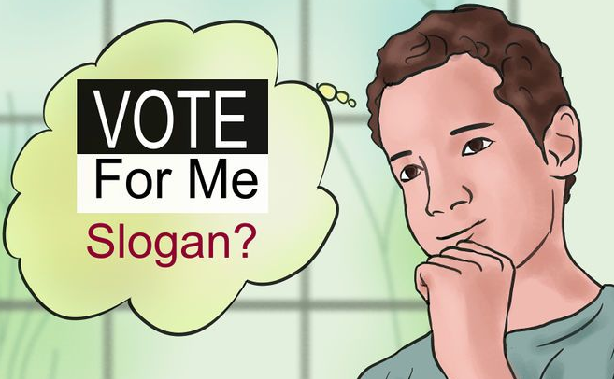
Introduction to Campaigning

Slide 2
What do you think Campaigning Is?
In Pairs, come up with your own definition of what you think campaigning is
Think both about the purpose of campaigning, and what practical steps would be involved
We will then look back at these at the end of the session to see if there is anything in your definition you would change/add

Slide 3
Examples of Types of Campaign
A public awareness campaign: Drink-driving, http://think.direct.gov.uk/drink-driving.html#
Advertising a product: https://www.youtube.com/watch?v=IajOINu0V2Y&list=PL7DF5EB5148CC31FE&index=12
Campaign/politics/influencing: https://www.youtube.com/watch?v=s2dNEQiHUUo
For each of these think about what they are trying to achieve and what you think would be effective about their approach

Slide 4
Tips for your Campaigns
There are lots of voters out there
What do voters want from you and the Union
Why should they trust you
How will you make a difference
Be Positive
Campaign for people to vote for you don't waste time campaigning / complaining about others
Keep it to the point, what's your key message (Unique Selling Point)
Who are your campaign team (how will they support you , how will you support them)
Different types of messages appeal to different peopleThink about the diversity of your student population
Don’t fail your degree over it

Slide 5
Campaign Scenarios
Work in small groups
We are going to highlight some responses you might get when you are campaigning
For each scenario, discuss in your group how you would respond
We will then feedback at the end to see what people thought the best responses were

Slide 6
Elevator Pitch
Ahead of running in the election, you will have been thinking of all the things you would like to do if you are elected and writing your manifesto
Hopefully people will read this, but often when campaigning you will only get 30 seconds to tell a person or group why they should vote for you
In pairs, practice summarising your key points in 30 seconds – then offer each other constructive feedback
We will go round the room to see how you are getting on

Slide 7
Question and Answer
Before we finish, a final chance for questions
Either related to the rules and what you can and can’t do
or around effective campaigning

