Slide 1
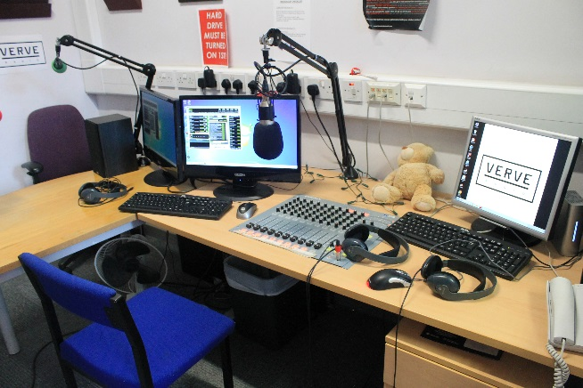
Getting started
The Students’ Union is an independent charitable organisation lead by students via a number of full-time and part-time student officers, supported by a team of full-time staff.
We are currently based remotely but usually based based at the Holloway and Aldgate campuses
Student Rep scheme is a partnership between the Student’s Union and the University.
There should be student rep for each year of each course at the University
Student Reps are able to achieve an accreditation and recognition on degree transcripts.
Student Reps can develop excellent transferable skills such as problem solving, negotiation, communication, lobbying and campaigning
Being a student rep can be rewarding, enjoyable and help you to get to know other student and a great way to get more involved the Students Union

Slide 2
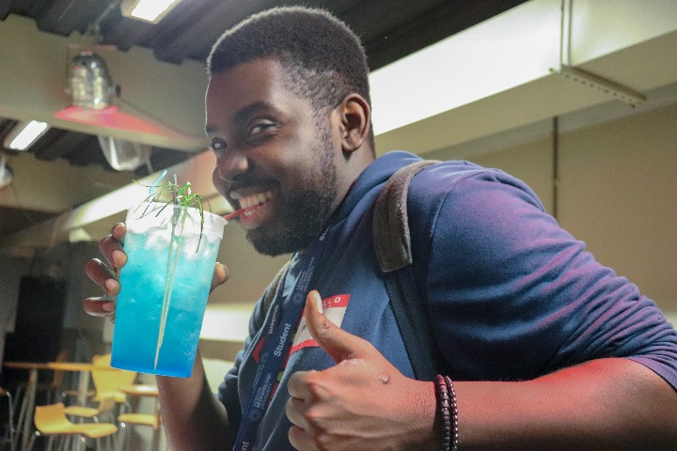
The Quality Assurance Agency (QAA) along with the Office for Students (OfS) act as ‘Watchdogs’ for Higher Education in the UK. The university follows the QAA's UK Quality Code for Higher Education, which is used to assure the standards and quality of UK higher education assure and commits the university to achieving positive outcomes for all students
The Academic Quality and Development (AQD) team at London Met ensures the university complies with the Code and the expectations of any other external regulatory bodies who accredit our courses, eg. British Psychological Society (BPS) The university has its on Quality Manual
The student focussed work AQD is supporting in 2020/21:
AQD runs London Met’s student feedback surveys - Student Experience Survey, University Survey & The NSS campaign - more on the next slide.
AQD support the Student Experience Sub Committee & take part in training reps (look out for advanced training)
Developed the Students as Partners & Partnership Agreements with students and the SU.
Recruiting, Training and Supporting Student Panel Members to sit on course approval and validation panels
Ensuring stronger student voice in course development & enhancement - now called Course Enhancement Process
Improving closing the feedback loop
Student Reps are so important to the work of Quality Enhancement at the university - You are our eyes and ears on the ground

Slide 3
The Student Experience survey is about student satisfaction at a modular level on academic experience.
It runs once per semester (Semester 1 is 9th until 20th of November)
Students will be sent a maximum of 4 links per semester from ‘yourvoice@londonmet.ac.uk’ or they can complete through the MyDay App
It's important students complete each one so we know what is and isn't working
It really does lead to change - staff have to produce action plans based on these results which will be shared with students
In 2018 participation rates where at 15% in 2019 with helps of staff and reps we got this closer to 40% in 2020 we want to get over 50%
Module leaders will be expected to encourage students to complete these surveys, as reps you should also be encouraging students to do it too. If staff arent doing this let AQD/SU staff know. They will also be expected to feedback to all students after the survey (in person or through weblearn) this data will feed into Course Enhancement Process (CEP).
The ‘Welcome Survey’ ran in week 1 & 2 and had 1600 responses - More information about the results of that can be found here (Link to come)
The National Student Survey(NSS) - for final year undergrad students - it is run nationally and critical to providing info for prospective & current students. It runs in 2nd semester.
PTES/PRES - Is the equivalent surveys to NSS for graduating PG Taught/PG Research students

Slide 4
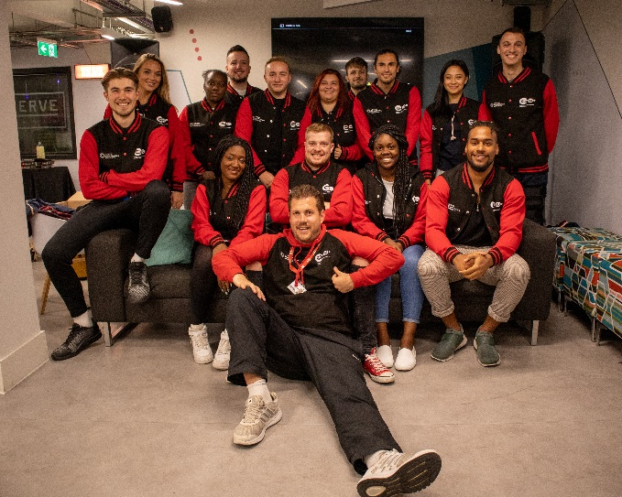
Student Rep - advice and support
Student Rep handbook 2020-21
Student Rep Weblearn Organisation (will look at later) it is called Student Reps 2020-21. Check your weblearn it contains various resources, minutes of past meetings and discussion forms so get involved in the conversation with other student reps
Students’ Union student rep website and who’d who page
Student Engagement Partnership (NUS and Higher Education sector collaboration) for best practice, training, support, engagement with institution etc):
London Met student zone (for school and University information)

Slide 5
Students’ Union Election Officer contacts & staff
School | Full-time (Sabbatical) Officer: | Part-time Officer:
School of Social Sciences | Cynthia Edo <cynthia.edo@londonmet.ac.uk> | Aysha Topping <aysha.topping@londonmet.ac.uk>
School of Social Professions | Cynthia Edo <cynthia.edo@londonmet.ac.uk> | Godwin Akinyemi <godwin.akinyemi@londonmet.ac.uk>
Guildhall School of Business and Law | Matthew Babb <Matthew.babb@londonmet.ac.uk> | Melany Monteiro Moniz <melany.moniz@londonmet.ac.uk>
School of Human Sciences | Matthew Babb <Matthew.babb@londonmet.ac.uk> | Oeste Carlton <oeste.carlton@londonmet.ac.uk>
School of Computing and Digital Media | Precious Agho <precious.agho@londonmet.ac.uk> | Max Strassman <max.strassman@londonmet.ac.uk>
School of Art, Architecture and Design | Precious Agho <precious.agho@londonmet.ac.uk> | vacant
Eddie Rowley, Student Voice Coordinator e.rowley@londonmet.ac.uk (Students’ Uniion staff)
Conor Muray-Gauld, Student Engagement Manager c.murraygauld@londonmet.ac.uk (University staff)

Slide 6
Staff contact points : Uni and SU
You main staff contact should be your lecturers, module leaders and course leaders.
Then, if you need to speak to someone ‘higher up’ it is the Head of Student Experience for your school:
Social Sciences | Steven Curtis <s.curtis@londonmet.ac.uk>
Social Professions | Brian Tutt <b.tutt@londonmet.ac.uk>
Guildhall School of Business and Law | Jan Bamford <j.bamford@londonmet.ac.uk>
Human Sciences | Sheelagh Heugh <s.heugh@londonmet.ac.uk>
Computing and Digital Media | Elena Moschini <e.moschini@londonmet.ac.uk>
Art, Architecture and Design | Cecile Tschirhart <c.tschirhart@londonmet.ac.uk>

Slide 7
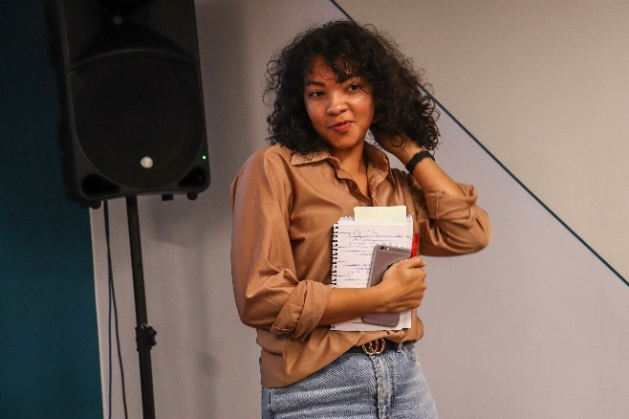
What is the role of a Student Rep?
To represent students’ views and opinions on all matters relating to teaching and learning in an effort to continuously improve the student learning experience in partnership with the University and Students’ Union.
Identify relevant issues on the ground
Raise issues and concerns with school
Be a channel of communication between school, student and students’ union
Feedback to course mates on any, some or no progress on the issues
Provide general and specific feedback (positive and otherwise) to school
Build strong working-relationship with course leader & module leader etc

Slide 8
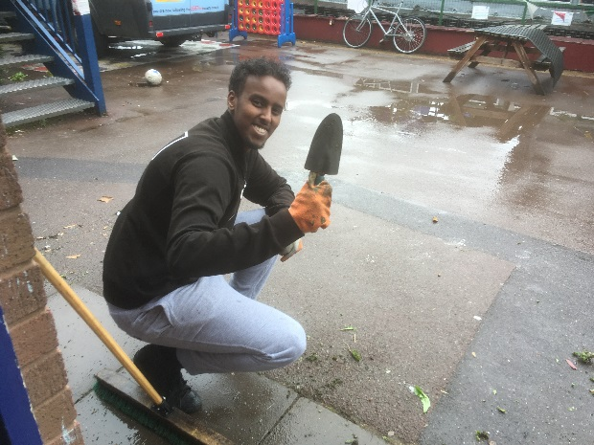
How can you make sure your course mates know you are their rep?
lecture shout-outs – ask your lecturer if you can speak to the course on collaborate either before or after a class.
Collect the names and emails/numbers of the students on your course - ask them to put their names etc into the ‘chat’ on collaborate so you can copy and paste them.
Ask your course leader to put your name and details on the Course Site feature on Weblearn (see next slide)
Ask you course leader to put up a weblearn announcement to introduce you to the course or you can ask them to forward on an email from you to the whole course
Creat a short online survey via google forms or survey monkey asking them how they are finding this new way of learning and ask your Course Leader to distribute it via weblearn
Create a Facebook or WhatsApp group for student on your course

Slide 9
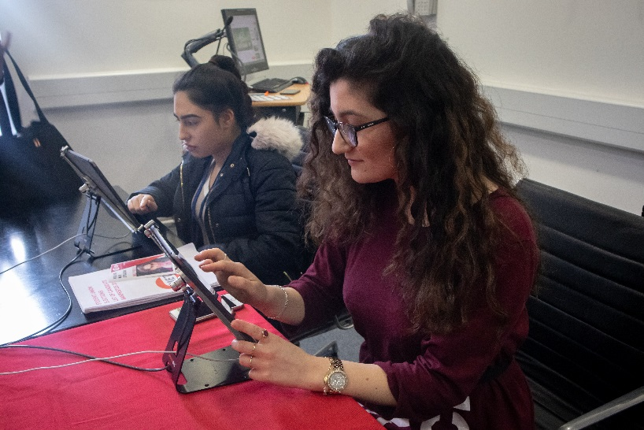
Feedback
Providing feedback to the university is one of the key roles of student reps. What sort of issues might you might provide feedback to the university on?
Quality of teaching and learning
Student’s intellectual development
Structure and organisation of the course
Availability and access to teaching staff
Exams and assessments
Library and IT facilities
University support facilities e.g. Disability & Dyslexia service
Placements and specific course related programmes
A good rep will give rounded, constructive and fair feedback both positive and no-so-positive comments.

Slide 10
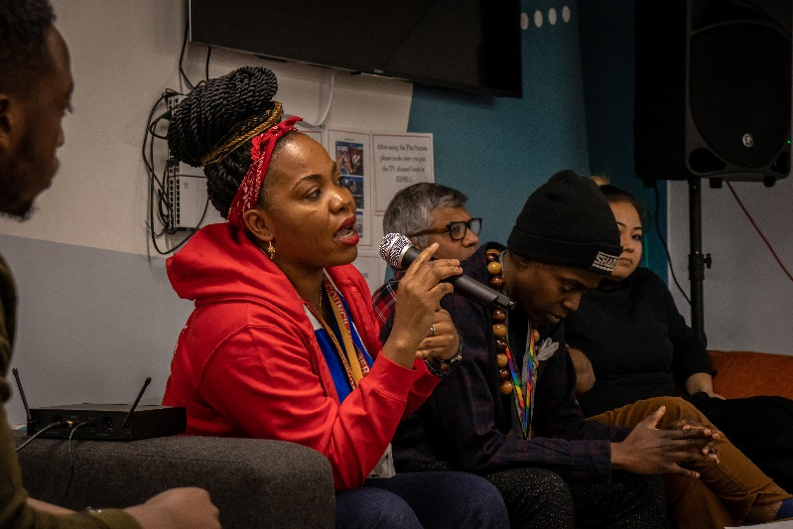
Ways to tackle issues – points to remember
Most of the time issues for Student Reps to tackle will effect a number of students and likely the whole module or course
If an issue affects just one individual you are probably best signposting them see signposting / referral guide.
If they need help with studies then tell them to speak to a member of teaching staff
If its an academic issue affecting just them such as an allegation of plagiarism, an appeal, complaint or similar refer them to the Students’ Union’s Casework Advice Service
If the issue is an IT or media issue or an Estates issue i.er. Something needs fixing, cleaning or replacing then please report it yourself via the Estates and IT portal.
If you cannot resolve the issue at this level then you can escalate it by taking it to your Course Leader, If further escalation is required then go to your school’s Head of Student Experience.
Always report back to your course mates on what you have done and what the response it. Even if you have had little response – tell the student on your course that! This is called ‘closing the feedback loop’

