Slide 1
Student representatives 2019-20
briefing for students

Slide 2
What are student reps?
students who are elected by and from students on their course in their year.
They liaise with students to identify academic or related any issues which may require addressing and then liaise with the course leader and other teaching staff
Provide feedback on course, teaching, facilities to course leader / teaching staff on course
They have the opportunity to sit to their school’s internal committees
They have the opportunity to sit on the student council which is the main discussion & debating body within the students’ union and through this to sit on the students’ union board of trustees, university academic board and other university decision-making bodies
Become an accredited student rep – certificate and mention on transcript when elected

Slide 3
What else do student reps do?
Signpost students on the course towards relevant university support services which they might find useful e.g. students’ union casework advice service and student services
Keep students on the course up-to-date and informed on Students’ Union and university activities and events
Get involved in other student union activities, events and campaigns
Attend national union of students (NUS) events aimed at student reps from across London and across the uk
Get to know other student reps and student union volunteers

Slide 4
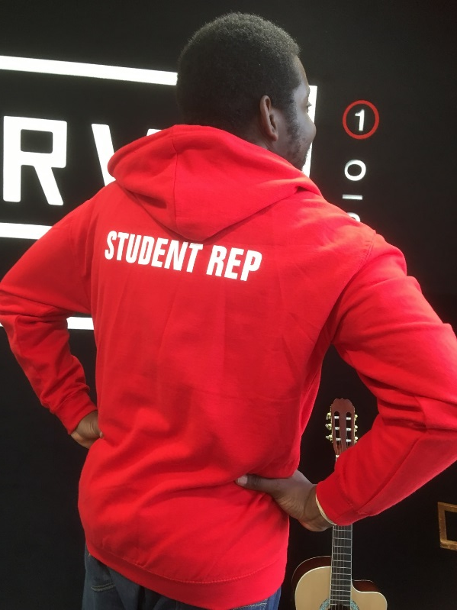
Why should you be a student rep?
You want to take a more active part in your course, school and university
Learn and develop skills such as problem solving, negotiation and
communication
End of year certificate
Get your efforts as a student rep volunteer mentioned on your degree
transcript when you graduate
Free hoody!

Slide 5
More information?
Speak to your course leader now or after class
www.londonmetsu.org.uk/studentreps
Email: studentreps.su@londonmet.ac.uk
Phone: 0207 133 4171
In person: SU Holloway & CMG-20 Calcutta house

