Slide 1
Course Committee Structure
A general review and evaluation of course
Ask your course leader when your course committee meeting is and write it in your diary
Your course may be ‘clustered’ with other courses in 2020-21
Course committees usually meet once each semester
Course leaders will chair them. Staff who teach on the course and the student reps should attend. Library and Quality Enhancement Unit may also attend
Should consider teaching, teaching and administrative issues surrounding the course
Minutes are taken which you should you should receive copies of the minutes.
Course Committees are useful but by no means the only forums to raise issues – so don’t wait until they come around. Be ready to raise issues as and when they crop up throughout the year.

Slide 2
Before a course committee meeting
Liaise with course leader beforehand so they can let you know what to expect
Read the agenda, be aware what is and what is not on it.
Make sure you have identified the issues you wish to raise and have feedback from your class mates to back it up
If you have a complicated issue to raise or/and have the research/evidence to produce e.g. survey, emails from course mates; send them to the course leader before the committee meeting so they have a chance to digest the issue.
Liaise with other student rep who may attend (ask you course leader to put you in touch or look on the Weblearn organisation for student reps.
Speak to your school Full-time Officer officer, ask them to come along with you if you wish - but check with your course leader this is ok, it should be fine.
Makes sure you know where the meeting is (correct link) and be on time. Being late will not help your cause!

Slide 3
During a course committee meeting
Listen
Raise ‘hand’ to speak or contribute vuia chat (its better to speak tihouigh)
Raise you issues clearly and concisely
Present any evidence you have
Don’t be confrontational, work in partnership
Take notes, ask for clarification if you are not sure what is being said
Remembers to note down action points
If you don’t understand a term used, ask!
At the end of the meeting clarify the decisions taken and when they are to be actioned (this prevents drift)
Confirm the date of the next meeting. Request a follow-up meeting to deal with a specific issues if required.

Slide 4
After a course committee meeting
If other Student Reps are present have a debrief straight away
Write up you notes and action points right away
Feedback to your course mates and your Full-time Officer ASAP
If you are not happy with the conduct of the meeting then speak to your Course Leader or another academic and express your concern
Provide any constructive criticism you have of the committee to the school

Slide 5
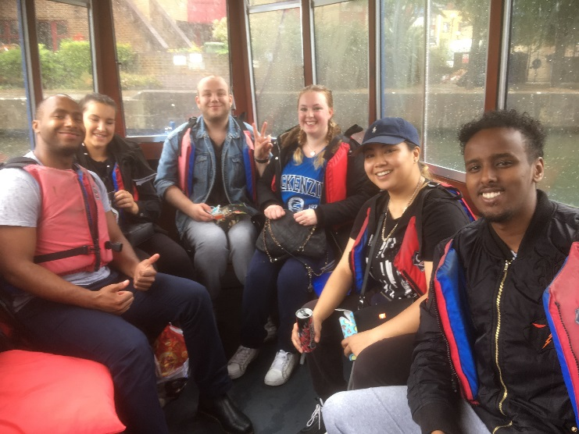
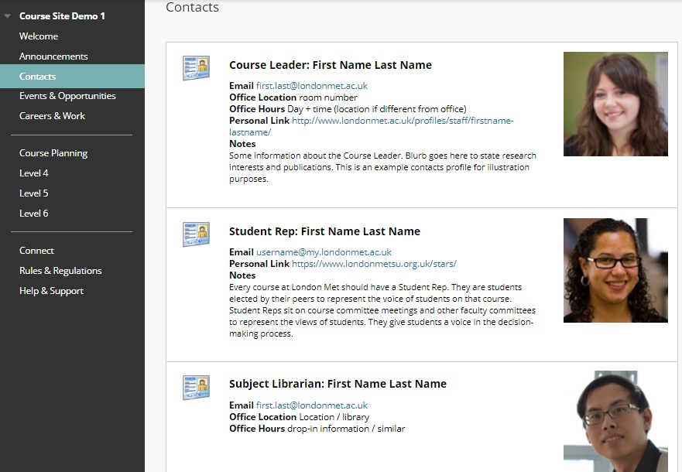
Weblearn Organisation:
Course sites
This is a weblearn feature which really helps with the presence of student reps. You will need to email your course leader the following to activate it:
Confirmation you wish to be mentioned on the Course Site
Your email and photo (jpeg)
A few lines introducing yourself
A link if you wish. This could be to a google form or survey monkey which you might want to set up so to gather feedback from your classmates

Slide 6
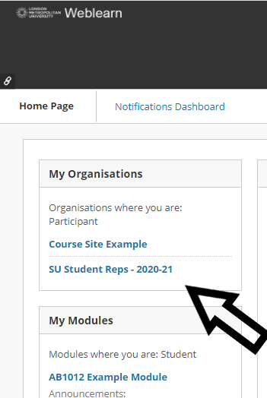
Weblearn Organisation:
Student Reps 2020-21
We have set this up new for 2020-21. You should be automatically enrolled on it. It includes:
Full list of student reps including emails for all student reps in the schools
Student rep handbook and all other training material for student reps (including these training presentation)
It also has a great discussion forums on it so Student reps can communicate quickly and easily with each other, the full-time officer, discuss, provide feedback etc
Use the discussion forums to post about what happening in your course and share your experiences - don’t mention any staff or student on it by name though

Slide 7
Weblearn: Task to complete
Please log on to your weblearn. You should see that you have been enrolled into an organsation called Student Reps 2020-21
Take a look round
Please look at the announcements. You will notice some discussion threads on them one is called Student Rep Training discussion threads
Please either start a discussion thread, or comment on an existing thread. There are various threads on different topics you can post on, or start your own!
Please also give us some feedback on this training - how did you find it? Suggestions?
You MUST contribute to a discussion forum to complete this training so please do it now!
If you have any provblems with the weblearn orgasnation please email Eddie on e.rowley@londonmwet.ac.uk

